Slide 1
PBCST304 Object Oriented Programming in Java
Module 4
(Part 5)
Prepared by
Renetha J.B.

Slide 2
Topics
Swings
  Swing Layout Managers

Slide 3
Swing Layout Managers
A layout manager automatically arranges our controls within a window by using some type of algorithm.
Each Container object has a layout manager associated with it.
A layout manager is an instance of any class that implements the LayoutManager interface.
The layout manager is set by the setLayout( ) method.
  If no call to setLayout( ) is made, then the default layout manager is used.
The setLayout( ) method has the following general form:
void setLayout(LayoutManager layoutObj)

Slide 4
Swing Layout Managers(contd.)
The layout manager is notified each time we add a component to a container.
Each layout manager keeps track of a list of components that are stored by their names.
Whenever the container needs to be resized, the layout manager is consulted via its minimumLayoutSize( ) and preferredLayoutSize( ) methods.
  Each component that is being managed by a layout manager contains the getPreferredSize( ) and getMinimumSize( ) methods.

Slide 5
Java has several predefined LayoutManager classes,
  FlowLayout
  BorderLayout
  GridLayout
  CardLayout
  GridBagLayout

Slide 6
FlowLayout
The direction of the layout is governed by the container’s component orientation property, which, by default, is left to right, top to bottom.
In Flow Layout
  components are laid out line-by-line beginning at the upper-left corner.
  When a line is filled, layout advances to the next line.
  A small space is left between each component, above and below, as well as left and right.
The constructors for FlowLayout:
  FlowLayout( )
  FlowLayout(int how)
  FlowLayout(int how, int horz, int vert)

Slide 7
FlowLayout(contd.)
  FlowLayout( ) creates the default layout, which centers components and leaves five pixels of space between each component.
  FlowLayout(int how) lets us specify how each line is aligned.
  Valid values for how are as follows:
    FlowLayout.LEFT
    FlowLayout.CENTER
    FlowLayout.RIGHT
    FlowLayout.LEADING
    FlowLayout.TRAILING
      These values specify left, center, right, leading edge, and trailing edge alignment, respectively.
  FlowLayout(int how, int horz, int vert) allows us to specify the horizontal and vertical space left between components in horz and vert, respectively.

Slide 8
import java.awt.*; import java.awt.event.*;
import javax.swing.*;
class EventDemoSwing extends JFrame implements ActionListener{
JLabel jlab;
JFrame jfrm;
JButton jbtnOk;
JButton jbtnCancel;
EventDemoSwing()
{
jfrm = new JFrame("An Event Eg");
jfrm.setLayout(new FlowLayout());
jfrm.setSize(220, 90);
jfrm.setDefaultCloseOperation(JFrame.EXIT_ON_CLOSE);
jbtnOk = new JButton("OK");
JButton jbtnCancel = new JButton("Cancel");
jbtnOk.setToolTipText("click");
jbtnOk.addActionListener(this);
jbtnCancel.addActionListener(this);
jfrm.add(jbtnOk);
jfrm.add(jbtnCancel);
jlab = new JLabel("Press a button.");
jfrm.add(jlab);
jfrm.setVisible(true); }
public void actionPerformed(ActionEvent ae)
{
String s = ae.getActionCommand();
if(s.equalsIgnoreCase("ok"))
jlab.setText("OK pressed.");
else if(s.equalsIgnoreCase("cancel"))
jlab.setText("Cancel pressed.");
}
public static void main(String args[])
{SwingUtilities.invokeLater(new Runnable()
{
public void run()
{ new EventDemoSwing();
} } );
} }

Slide 9


FlowLayout(contd.)
If in code we modify the layout as
jfrm.setLayout(new FlowLayout(FlowLayout.LEFT));

Slide 10
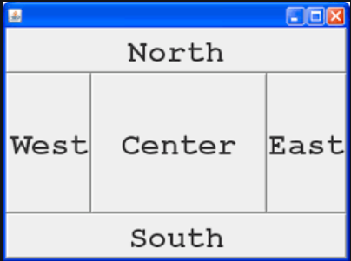
BorderLayout
By default, the content pane associated with a JFrame uses border layout.
The BorderLayout class implements a common layout style for top-level windows.
It has four narrow, fixed-width components at the edges and one large area in the center.
The four sides are referred to as
  North,
  South
  East
  West.
The middle area is called
  Center

Slide 11
BorderLayout(contd.)
The constructors defined by BorderLayout:
BorderLayout( )
BorderLayout( ) creates a default border layout.
BorderLayout(int horz, int vert) specify the horizontal and vertical space left between components in horz and vert, respectively

Slide 12
BorderLayout(contd.)
BorderLayout defines the following constants
  BorderLayout.CENTER
  BorderLayout.SOUTH
  BorderLayout.EAST
  BorderLayout.WEST
  BorderLayout.NORTH
When adding components, you will use these constants with the following form ofadd( ), which is defined by Container:
void add(Component compObj, Object region)
  Here, compObj is the component to be added, and region specifies where the component will be added.

Slide 13
import java.awt.*; import java.awt.event.*;
import javax.swing.*;
class EventDemoSwing extends JFrame implements ActionListener{
JLabel jlab;
JFrame jfrm;
JButton jbtnOk;
JButton jbtnCancel;
EventDemoSwing()
{
jfrm = new JFrame("An Event Eg");
jfrm.setLayout(new BorderLayout ());
jfrm.setSize(220, 90);
jfrm.setDefaultCloseOperation(JFrame.EXIT_ON_CLOSE);
jbtnOk = new JButton("OK");
JButton jbtnCancel = new JButton("Cancel");
jbtnOk.setToolTipText("click");
jbtnOk.addActionListener(this);
jbtnCancel.addActionListener(this);
jfrm.add(jbtnOk,BorderLayout.EAST);
jfrm.add(jbtnCancel, BorderLayout.WEST);
jlab = new JLabel("Press a button.");
jfrm.add(jlab BorderLayout.NORTH);
jfrm.setVisible(true); }
public void actionPerformed(ActionEvent ae)
{
String s = ae.getActionCommand();
if(s.equalsIgnoreCase("ok"))
jlab.setText("OK pressed.");
else if(s.equalsIgnoreCase("cancel"))
jlab.setText("Cancel pressed.");
}
public static void main(String args[])
{SwingUtilities.invokeLater(new Runnable()
{
public void run()
{ new EventDemoSwing();
} } );
} }

Slide 14

BorderLayout(contd.)

Slide 15
Using Insets
Sometimes we may want to leave a small amount of space between the container that holds the components and the window that contains it.
  To do this, override the getInsets( ) method that is defined by Container.
  getInsets( ) method returns an Insets object that contains the top, bottom, left, and right inset to be used when the container is displayed.
  These values are used by the layout manager to inset the components when it lays out the window
The constructor for Insets is shown here:
Insets(int top, int left, int bottom, int right)
  The values passed in top, left, bottom, and right specify the amount of space between the container and its enclosing window

Slide 16
Using Insets(contd.)
The getInsets( ) method has this general form:
Insets getInsets( )
  When overriding this method, we must return a new Insets object that contains the inset spacing you desire.

Slide 17
  GridLayout
GridLayout lays out components in a two-dimensional grid.
  We can define the number of rows and columns.
The constructors supported by GridLayout are
GridLayout( )
GridLayout(int numRows, int numColumns)
GridLayolayoutut(int numRows, int numColumns, int horz, int vert)
  GridLayout( ) creates a single-column grid
  GridLayout(int numRows, int numColumns) creates a grid layout with the specified number of rows and columns.
  GridLayolayoutut(int numRows, int numColumns, int horz, int vert) allows us to specify the horizontal and vertical space left between components in horz and vert, respectively. Either numRows or numColumns can be zero. Specifying numRows as zero allows for unlimited-length columns.

Slide 18
import java.awt.*;
import java.awt.event.*;
import javax.swing.*;
class GridDemo extends JFrame implements ActionListener
{ JLabel jlab;
JFrame jfrm;
GridDemo()
{ jfrm = new JFrame("An Event Eg");
jfrm.setLayout(new GridLayout (2,2));
jfrm.setSize(220, 90);
jfrm.setDefaultCloseOperation(JFrame.EXIT_ON_CLOSE);
JButton jbtnOne = new JButton("One");
JButton jbtnTwo= new JButton("Two");
JButton jbtnThree = new JButton("Three");
JButton jbtnFour = new JButton("Four");
jbtnOne.addActionListener(this);
jbtnTwo.addActionListener(this);
jbtnThree.addActionListener(this);
jbtnFour.addActionListener(this);
jfrm.add(jbtnOne);
jfrm.add(jbtnTwo);
jfrm.add(jbtnThree);
jfrm.add(jbtnFour);
jfrm.setVisible(true);
}
public void actionPerformed(ActionEvent ae)
{ String s = ae.getActionCommand();
if(s.equalsIgnoreCase("one"))
jlab.setText("One pressed.");
else if(s.equalsIgnoreCase("two"))
jlab.setText("Two pressed.");
else if(s.equalsIgnoreCase("three"))
jlab.setText("Three pressed.");
else if(s.equalsIgnoreCase("four"))
jlab.setText("Four pressed.");
}
public static void main(String args[])
{SwingUtilities.invokeLater(new Runnable()
{ public void run()
{ new GridDemo(); } } );
}
}

Slide 19

jfrm.setLayout(new GridLayout (2,2));
This set 2 rows and 2 columns
Components are filled in order from first row first column
  (0,0) (0,1)
  (1,0) (1,1)

Slide 20
CardLayout
The CardLayout class is unique among the other layout managers in that it stores several different layouts.
Each layout can be thought of as being on a separate index card in a deck that can be shuffled so that any card is on top at a given time
This can be useful for user interfaces with optional components that can be dynamically enabled and disabled upon user input.
CardLayout provides these two constructors:
CardLayout( )
CardLayout(int horz, int vert)
  CardLayout( ) creates a default card layout.
  CardLayout(int horz, int vert) allows to specify the horizontal and vertical space left between components in horz and vert, respectively.

Slide 21
CardLayout(contd.)
The cards are typically held in an object of type Panel.
This panel must have CardLayout selected as its layout manager.
The cards that form the deck are also typically objects of type Panel

Slide 22
CardLayout(contd.)
We must create
  a panel that contains the deck and
  a panel for each card in the deck.
Next, we add components that form each card to the appropriate panel.
We then add these panels to the panel for which CardLayout is the layout manager.
Finally, we add this panel to the window.
Once these steps are complete, we must provide some way for the user to select between cards.
  One common approach is to include one push button for each card in the deck.

Slide 23
CardLayout(contd.)
Use add( ) when adding cards to a panel:
void add(Component panelObj, Object name)
  Here, name is a string that specifies the name of the card whose panel is specified by panelObj.
After we have created a deck, our program activates a card by calling one of the following methods defined by CardLayout:
  void first(Container deck)
  void last(Container deck)
  void next(Container deck)
  void previous(Container deck)
  void show(Container deck, String cardName)
  Here, deck is a reference to the container (usually a panel) that holds the cards, and cardName is the name of a card.
  Calling first( ) causes the first card in the deck to be shown. To show the last card, call last( ). To show the next card, call next( ). To show the previous card, call previous( ). Both next( ) and previous( ) automatically cycle back to the top or bottom of the deck, respectively. The show( ) method displays the card whose name is passed in cardName.

Slide 24
import java.awt.*;
import java.awt.event.*;
import javax.swing.*;
public class CardLayoutDemo extends JFrame implements ActionListener
{
CardLayout card;
JButton b1,b2,b3;
Container c;
CardLayoutDemo()
{
c=getContentPane();
card=new CardLayout(40,30);
//create CardLayout object with 40 hor space and 30 ver space
c.setLayout(card);
b1=new JButton("Apple");
b2=new JButton("Boy");
b3=new JButton("Cat");
b1.addActionListener(this);
b2.addActionListener(this);
b3.addActionListener(this);
c.add(b1);c.add(b2);c.add(b3);
}
public void actionPerformed(ActionEvent e)
{
card.next(c);
}
public static void main(String[] args)
{
CardLayoutDemo cl=new CardLayoutDemo();
cl.setSize(400,400);
cl.setVisible(true);
cl.setDefaultCloseOperation(EXIT_ON_CLOSE);
}
}

Slide 25
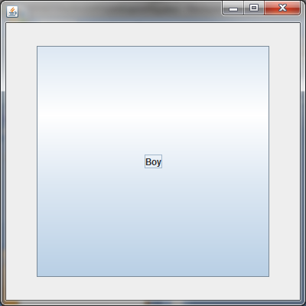
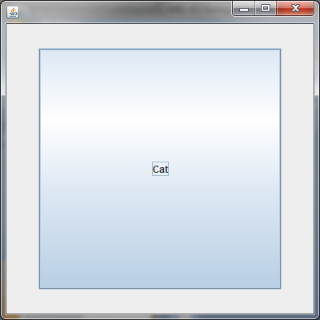
When we click the button it changes to next button like cards

Slide 26
GridBagLayout
We can specify the relative placement of components by specifying their positions within cells inside a grid using GridBagLayout.
The key to the grid bag is that each component can be a different size, and each row in the grid can have a different number of columns.
  This is why the layout is called a grid bag.
It’s a collection of small grids joined together.
The location and size of each component in a grid bag are determined by a set of constraints linked to it.
The constraints are contained in an object of type GridBagConstraints.
  Constraints include the height and width of a cell, and the placement of a component, its alignment, and its anchor point within the cell.

Slide 27
GridBagLayout(contd.)
The general procedure for using a grid bag is to
  first create a new GridBagLayout object and to make it the current layout manager.
  Then, set the constraints that apply to each component that will be added to the grid bag.
  Finally, add the components to the layout manager.
GridBagLayout defines only one constructor
GridBagLayout( )
GridBagLayout defines several methods, of which many are protected and not for general use.
One method is setConstraints( )
void setConstraints(Component comp, GridBagConstraints cons)

Slide 28
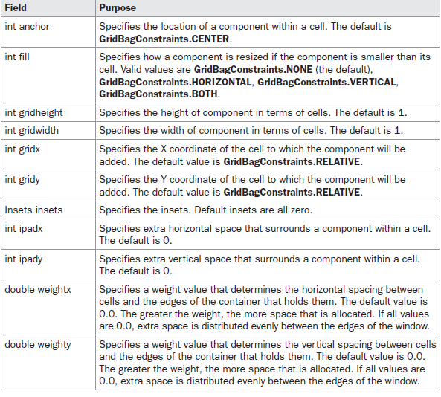
GridBagLayout(contd.)
GridBagConstraints defines several fields that to govern the size, placement, and spacing of a component.

Slide 29
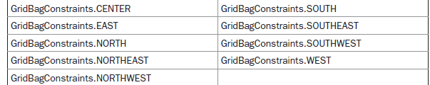
GridBagLayout(contd.)
GridBagConstraints also defines several static fields that contain standard constraint values, such as
  GridBagConstraints.CENTER
  GridBagConstraints.VERTICAL
When a component is smaller than its cell, you can use the anchor field to specify where within the cell the component’s top-left corner will be locate

Slide 30
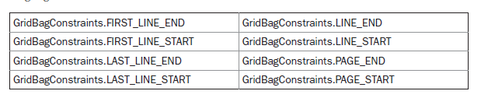
GridBagLayout(contd.)
The second type of values that can be given to anchor is relative, which means the values are relative to the container’s orientation,

Slide 31
import java.awt.*; import java.awt.event.*; import javax.swing.*;
public GridLayoutDemo() {
jfrm = new JFrame("An Event Eg");
GridBagLayout gbag = new GridBagLayout();
GridBagConstraints gbc = new GridBagConstraints();
jfrm.setLayout(gbag);
jfrm.setSize(520, 500);
jfrm.setDefaultCloseOperation(JFrame.EXIT_ON_CLOSE);
jbtnOk = new JButton("OK");
jbtnCancel = new JButton("Cancel");
jbtnOk.setToolTipText("click");
jbtnOk.addActionListener(this);
jbtnCancel.addActionListener(this);
//Define the grid bag. // Use default row weight of 0 for first row.
gbc.weightx = 1.0; // use a column weight of 1
gbc.ipadx = 200; // pad by 200 units gbc.insets = new Insets(4, 4, 10, 10); // inset slightly from top left
gbc.anchor = GridBagConstraints.NORTH;
gbc.gridwidth = GridBagConstraints.RELATIVE;
gbag.setConstraints(jbtnOk, gbc);
gbc.gridwidth = GridBagConstraints.REMAINDER;
gbag.setConstraints(jbtnCancel, gbc);

Slide 32
jlab = new JLabel("Press a button.");
jfrm.add(jbtnOk);
jfrm.add(jbtnCancel);
jfrm.add(jlab);
jfrm.setVisible(true);
}
public void actionPerformed(ActionEvent ae)
{
String s = ae.getActionCommand();
if(s.equalsIgnoreCase("ok"))
jlab.setText("OK pressed.");
else if(s.equalsIgnoreCase("cancel"))
jlab.setText("Cancel pressed.");
}
}

Slide 33
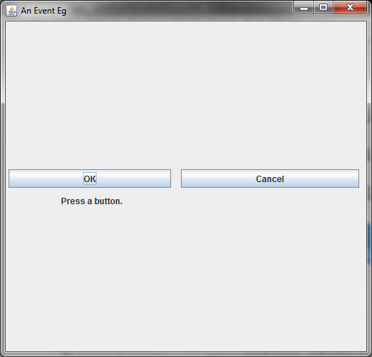

Slide 34
Reference
Herbert Schildt, Java: The Complete Reference, 8/e, Tata McGraw Hill, 2011.

